Slide 1
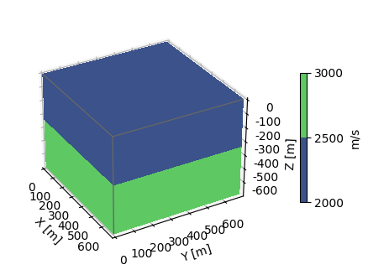
Problem setting:
Grids :70×70×70
Space :10m
Dt :1ms
T :1s
Wavelet: 20HZ
:Source location:[350,350,0] (m)
:receiver location:[350,i,700] i=[0,10,20,…,690](m)
……

Slide 2
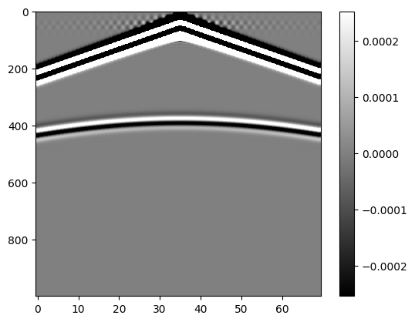
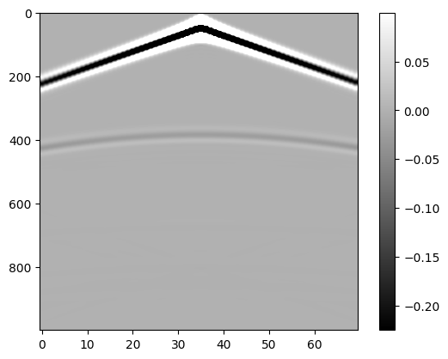
Ps3d
VS
PML=40
Fd3d

Slide 3
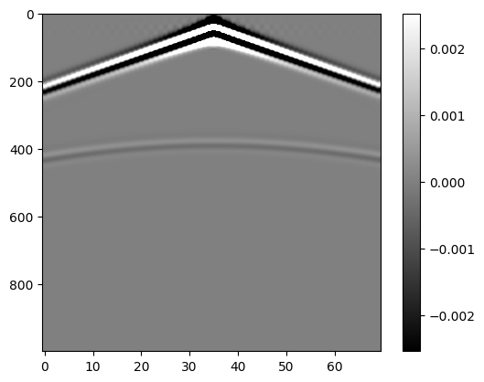



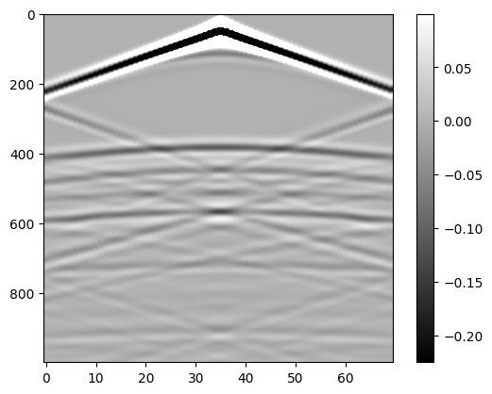



PML=5
PML=15
PML=25
PML=35
Ps3d
Fd3d

